Slide 1



Intelligent Agents
Belief, Desire, Intention (BDI)
Rachid Anane 2013 / Mark Tyers 2016

Slide 2
Outline
Agents attributes
Mental states
Belief-Desire-Intention (BDI)

Slide 3
Rational Agent
An agent that has clear preferences and always chooses to perform the action with the optimal expected outcome for itself from among all feasible actions.

Slide 4
Rational Behaviour
That which achieves one’s goals given one’s beliefs, or, that which is expected to maximise goal achievement, given the available information.

Slide 5
Agent Attributes
Autonomy
Reactivity
Proactiveness
Social ability
Agents are designed to meet specific objectives
They are goal-driven

Slide 6
Intentional Stance
In order to explain and predict the behaviour of an entity (object or system) humans often adopt the intentional stance.
In the intentional stance an entity is treated as a rational agent whose behaviour is governed by intentional states such as beliefs, desires and intentions.
In agent technology the intentional stance provides a powerful tool for dealing with complex systems.

Slide 7
Practical Reasoning
Practical reasoning is directed towards actions i.e. the process of deciding what to do.

Slide 8
Activities in Practical Reasoning
Deliberation: deciding what state of affairs we want to achieve
the outputs of deliberation are intentions
Means-ends reasoning: deciding how to achieve these states of affairs
the outputs of means-ends reasoning are plans.

Slide 9
Belief-Desire-Intention
A theory of practical reasoning.
Originally developed by M.E. Bratman in his book “Intentions, Plans, and Practical Reason” (1987)
Concentrates on the roles of the intentions in practical reasoning.

Slide 10
BDI
Beliefs (B)
Correspond to information the agent has about the world
Desires (D)
Represent states of affairs that the agent would (in an ideal world) wish to be brought about
Intentions (I)
Represent desires that the agent has committed to achieving

Slide 11
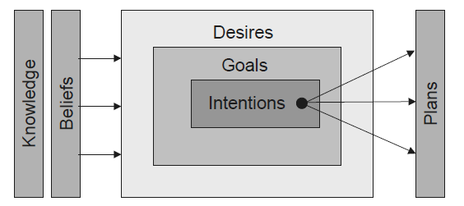
Rao and Georgeff (1995)

Slide 12
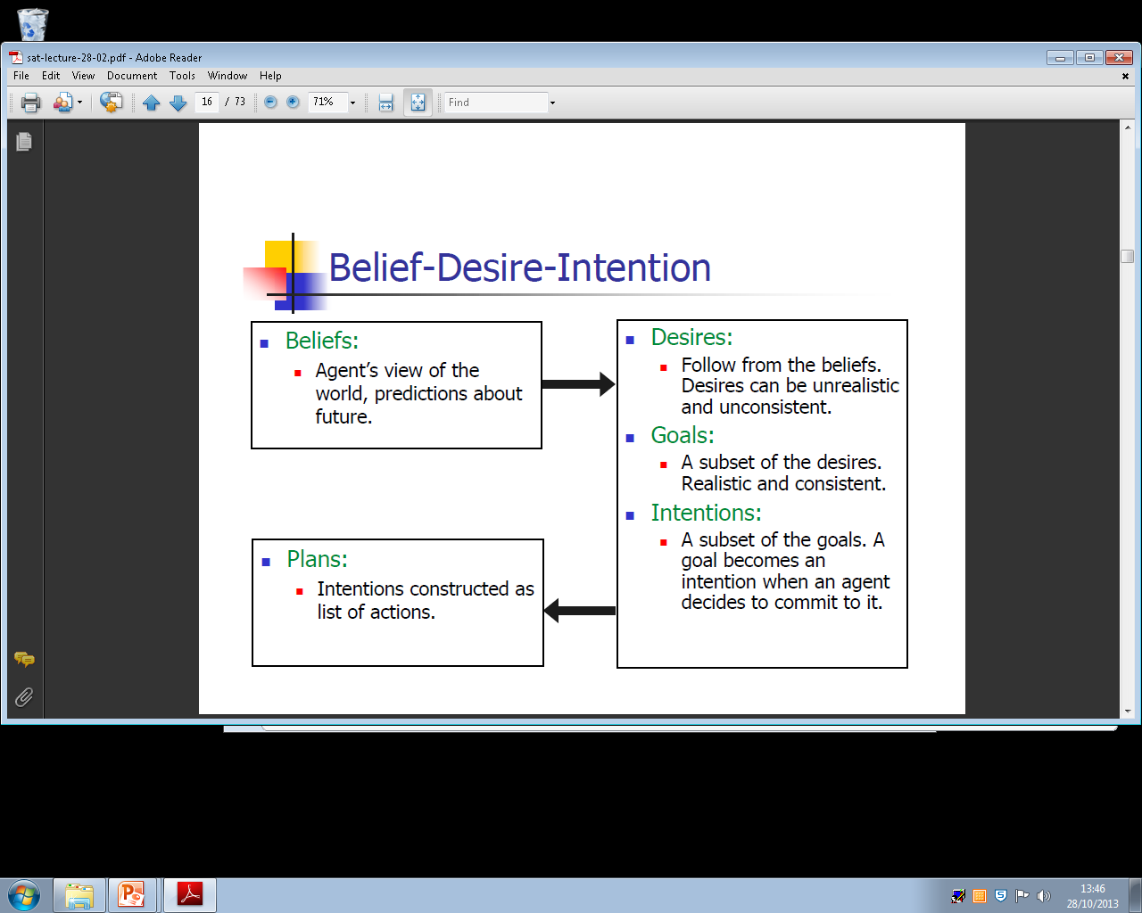
BDI

Slide 13
Intention (choice with commitment)
An autonomous agent should act on its intentions, not in spite of them
adopt intentions that are feasible, drop the ones that are not feasible
keep (or commit to) intentions, but not forever
discharge those intentions believed to have been satisfied
alter intentions when relevant beliefs change

Slide 14
Planning Agent
Within the symbolic AI community, it has long been assumed that some form of AI planning system will be a central component of any artificial agent.

Slide 15
Planning Agent Requirement
A representation of goal/intention to achieve
A representation of actions it can perform
A representation of the environment
The agent will generate a plan to achieve the goal

Slide 16
BDI Implementation Plans
In BDI implementations plans usually have:
a name
a goal: invocation condition that is the triggering event for the plan
a pre-condition list: list of facts which must be true for plan to be executed
a delete list: list of facts that are no longer true after a plan is executed
an add list: list of facts made true by executing the actions of the plan
a body: list of actions

Slide 17
Summary
We have covered:
Agents attributes
Mental states
Belief-Desire-Intention (BDI)

